Slide 1



SESSION NAME HERE
OOP: Inheritance

Slide 2


Software Engineering Lecture Housekeeping
The use of disrespectful language is prohibited in the questions, this is a supportive, learning environment for all - please engage accordingly. (FBV: Mutual Respect.)
No question is daft or silly - ask them!
There are Q&A sessions midway and at the end of the session, should you wish to ask any follow-up questions. Moderators are going to be answering questions as the session progresses as well.
If you have any questions outside of this lecture, or that are not answered during this lecture, please do submit these for upcoming Open Classes. You can submit these questions here: Open Class Questions
Notes:
https://forms.gle/2rap7ToKqx4ipYRq7

Slide 3
Software Engineering Lecture Housekeeping cont.
For all non-academic questions, please submit a query: www.hyperiondev.com/support
Report a safeguarding incident: www.hyperiondev.com/safeguardreporting
We would love your feedback on lectures: Feedback on Lectures

Slide 4


Define inheritance and its role in OOP.
2. Implement inheritance into your own classes.
Lecture Objectives

Slide 5

Recap on Previous Week

Slide 6


Classes in OOP
A class is a blueprint or template for creating objects. It defines the attributes and methods that all objects of that class will have.
Notes:
Provide examples of variable names and data types (e.g., int, float, string).
Show how to declare and assign values to variables in Python.
Provide examples of variable assignment using different data types.
Illustrate how to use variables in print statements and simple calculations.

Slide 7
Attributes
Attributes are values that define the characteristics associated with an object.
They define the state of an object and provide information about its current condition.
For a class named ‘House’, some relevant attributes could be:
Number of bedrooms
Year built

Slide 8
Methods (Behaviours)
Methods, also known as behaviours, define the actions or behaviours that objects can perform.
They encapsulate the functionality of objects and allow them to interact with each other and the outside world.
For a class named ‘House’, some relevant method could be:
set_location(): Allows updating the location of the house
https://www.freecodecamp.org/news/python-write-to-file-open-read-append-and-other-file-handling-functions-explained/

Slide 9
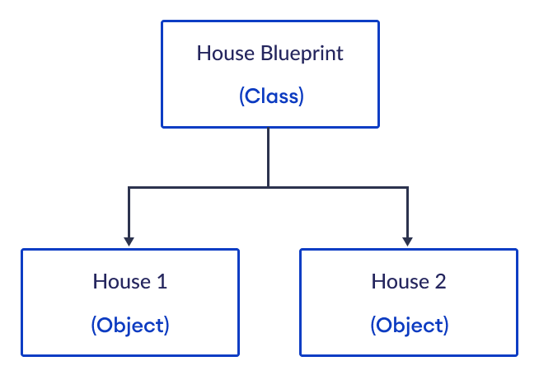

Slide 10


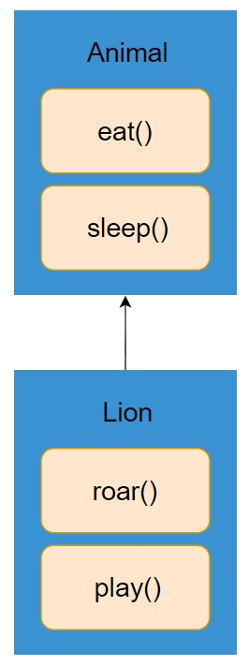
Inheritance

Slide 11
What is Inheritance?
Sometimes we require a class with the same attributes and properties as another class but we want to extend some of the behaviour or add more attributes.
Using inheritance we can create a new class with all the properties and attributes of a base class instead of having to redefine them.
Notes:
Provide examples of variable names and data types (e.g., int, float, string).
Show how to declare and assign values to variables in Python.
Provide examples of variable assignment using different data types.
Illustrate how to use variables in print statements and simple calculations.

Slide 12
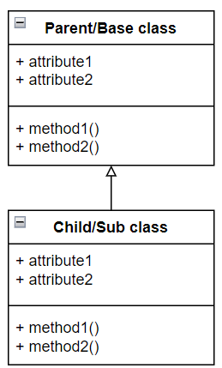
What is Inheritance?
Notes:
Provide examples of variable names and data types (e.g., int, float, string).
Show how to declare and assign values to variables in Python.
Provide examples of variable assignment using different data types.
Illustrate how to use variables in print statements and simple calculations.

Slide 13
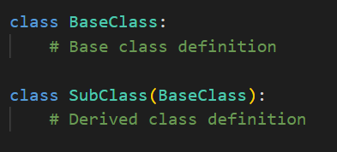
Inheritance
Parent/Base class
The parent or base class contains all the attributes and properties we want to inherit.
Child/Subclass
The sub class will inherit all of its attributes and properties from the parent class.
Notes:
Provide examples of variable names and data types (e.g., int, float, string).
Show how to declare and assign values to variables in Python.
Provide examples of variable assignment using different data types.
Illustrate how to use variables in print statements and simple calculations.

Slide 14
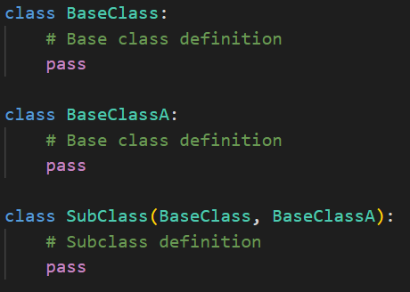
Multiple Inheritance
Python allows multiple inheritance as well.
This means we can have a subclass that inherits attributes and properties from more than one base class.
Notes:
Provide examples of variable names and data types (e.g., int, float, string).
Show how to declare and assign values to variables in Python.
Provide examples of variable assignment using different data types.
Illustrate how to use variables in print statements and simple calculations.

Slide 15
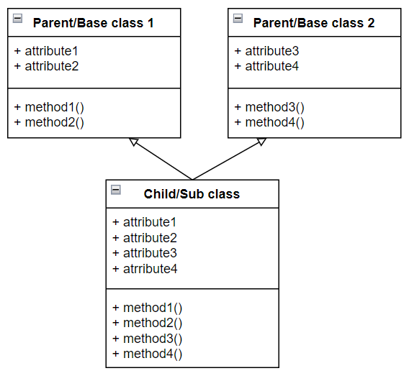
Multiple Inheritance
Notes:
Provide examples of variable names and data types (e.g., int, float, string).
Show how to declare and assign values to variables in Python.
Provide examples of variable assignment using different data types.
Illustrate how to use variables in print statements and simple calculations.

Slide 16
Method Overriding
We can override methods in our subclass to either extend or change the behaviour of a method.
To apply method overriding you simply need to define a method with the same name as the method you would like to override.
To extend functionality of a method instead of completely overriding we can use the super() function.
Notes:
Provide examples of variable names and data types (e.g., int, float, string).
Show how to declare and assign values to variables in Python.
Provide examples of variable assignment using different data types.
Illustrate how to use variables in print statements and simple calculations.

Slide 17
Super()
The super() function allows us to access the attributes and properties of our Parent/Base class.
Using super() followed by a dot “.” we can call to the methods that reside inside our base class.
When extending functionality of a method we would first want to call the base class method and then add the extended behaviour.
Notes:
Provide examples of variable names and data types (e.g., int, float, string).
Show how to declare and assign values to variables in Python.
Provide examples of variable assignment using different data types.
Illustrate how to use variables in print statements and simple calculations.

Slide 18
Methods overriding and Super()
The method you will override the most will be __init__()
When adding more instance attributes to the subclass we have to call to the base class __init__() to avoid having to redeclare all our base class attributes.
We can use super().__init__() to call the constructor of the base class and set the values of the inherited attributes.
Notes:
Provide examples of variable names and data types (e.g., int, float, string).
Show how to declare and assign values to variables in Python.
Provide examples of variable assignment using different data types.
Illustrate how to use variables in print statements and simple calculations.

Slide 19
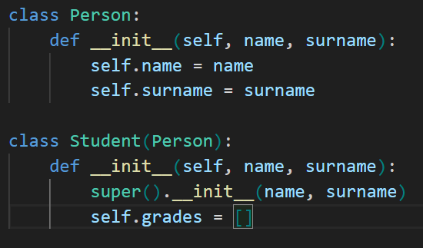
Methods overriding and Super()
Here we call __init__() from the Person class to set the values for the attributes “name” and “surname”.
Notes:
Provide examples of variable names and data types (e.g., int, float, string).
Show how to declare and assign values to variables in Python.
Provide examples of variable assignment using different data types.
Illustrate how to use variables in print statements and simple calculations.

Slide 20
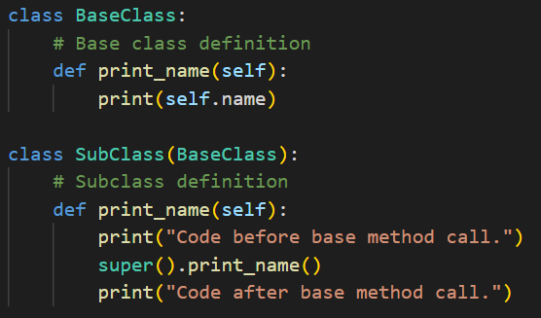
Methods overriding and Super()
Notes:
Provide examples of variable names and data types (e.g., int, float, string).
Show how to declare and assign values to variables in Python.
Provide examples of variable assignment using different data types.
Illustrate how to use variables in print statements and simple calculations.

Slide 21
isinstance() and issubclass()
We can determine if an object is an instance of a particular class using isinstance()
E.g. isinstance(object, ClassType)
We can determine if a class is a subclass of another class using issubclass()
E.g. issubclass(SubClass, BaseClass)
Notes:
Provide examples of variable names and data types (e.g., int, float, string).
Show how to declare and assign values to variables in Python.
Provide examples of variable assignment using different data types.
Illustrate how to use variables in print statements and simple calculations.

Slide 22
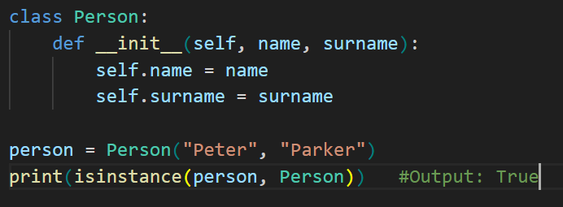
isinstance()
Notes:
Provide examples of variable names and data types (e.g., int, float, string).
Show how to declare and assign values to variables in Python.
Provide examples of variable assignment using different data types.
Illustrate how to use variables in print statements and simple calculations.

Slide 23
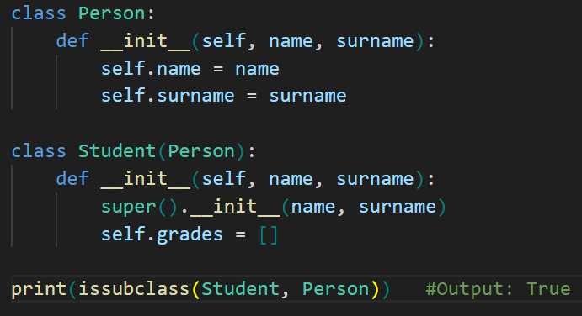
issubclass()
*
Notes:
Provide examples of variable names and data types (e.g., int, float, string).
Show how to declare and assign values to variables in Python.
Provide examples of variable assignment using different data types.
Illustrate how to use variables in print statements and simple calculations.

Slide 24


Progression Criteria
✅ Criterion 1: Initial Requirements
Complete 15 hours of Guided Learning Hours and the first four tasks within two weeks.
✅ Criterion 2: Mid-Course Progress
Software Engineering: Finish 14 tasks by week 8.
Data Science: Finish 13 tasks by week 8.
✅ Criterion 3: Post-Course Progress
Complete all mandatory tasks by 24th March 2024.
Record an Invitation to Interview within 4 weeks of course completion, or by 30th March 2024.
Achieve 112 GLH by 24th March 2024.
✅ Criterion 4: Employability
Record a Final Job Outcome within 12 weeks of graduation, or by 23rd September 2024.
CONFIDENTIAL

Slide 25
Unlock Prestigious Co-Certification Opportunities
New Partnerships Unveiled!
University of Manchester & Imperial College London join our circle along with The University of Nottingham Online.
Exclusive Opportunity:
Co-certification spots awarded on a first-come basis.
Meet the criteria early to gain eligibility for the co-certification.
Key Deadlines:
11 March 2024: 112 Guided Learning Hours & 'Build Your Brand' tasks completion.
18 March 2024: Record interview invitation or self-employment.
15 July 2024: Submit verified job offer or new contract.
Notes:
Presenter's Notes:
Stress the exclusivity and value of the new university co-certification.
Clarify the updated criteria and the importance of adhering to the new deadlines.
Motivate the audience to take action promptly- all links to can be found on the dashboard. "I have some important updates regarding our Skills Bootcamp that I'm eager to share with you. We're committed to not only providing you with a top-tier learning experience but also to enhancing the value of your hard work through prestigious recognitions. With that goal in mind, we've expanded our co-certification partnerships. CoGrammar has introduced new co-certification opportunities in collaboration with the University of Manchester and Imperial College London, adding to our partnership with The University of Nottingham Online. These prestigious co-certifications are awarded on a first-come basis and IN ORDER TO BE ELIGIBLE you are required to meet updated criteria. Ensure you complete 112 Guided Learning Hours and all ‘Build Your Brand’ tasks, this includes been submitted and passed, by 11th March 2024. Also, you must record an interview invitation or a self-employment declaration by 18th March 2024, and submit verified job offers or contracts by 15th July 2024. Don't miss out on this valuable addition to your professional qualifications. Let's meet these deadlines and achieve excellence together!"

Slide 26
Questions around the Inheritance

Slide 27

Thank you for joining

